Slide 1

Infant Carrier Seat and Baby Presence Detection on Car Passenger Seat using FIUS Sensor
Course: Information Technology
Modules: Autonomous Intelligent Systems and Machine Learning
Under the guidance of
Dr. Peter Nauth and Dr. Andreas Pech
Team members:
Mandar Gokul Kale (1501517)
Anushruthpal Keshavathi Jayapal (1502741)
Lavanya Suresh (1516065)
Aswini Thirumaran (1510315)

Slide 2
OBJECTIVE
This project develops a sensor-based system to detect baby carrier seats and infants in car seats, even under challenging conditions like blankets or sunscreens.
It uses machine learning algorithms (MLP, SVM, Random Forest, XGBoost) to analyze ultrasonic sensor data processed with Fast Fourier Transform.
Model performance is evaluated using correlation analysis and confusion matrices.
The system enhances safety by improving infant detection accuracy and minimizing false positives. It also optimizes sensor reliability and real-time data processing for automotive safety.

Slide 3
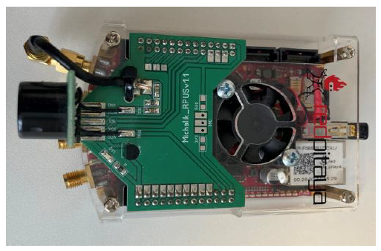
RED PITAYA – FIUS SENSOR
Red Pitaya is an open-source measurement and control platform used for signal processing, automation, and electronics.
It features a System-on-Chip (SoC) architecture (FPGA + ARM processor) for real-time signal analysis.
The SRF02 Ultrasonic Sensor measures distances from 15 cm to 6 meters with 1 cm resolution, using ultrasonic waves.
It supports I2C & Serial UART communication, making it compatible with Red Pitaya, microcontrollers, and Raspberry Pi.
Applications include automotive safety, robotics, industrial automation, and machine learning-based object detection.
Red Pitaya

Slide 4
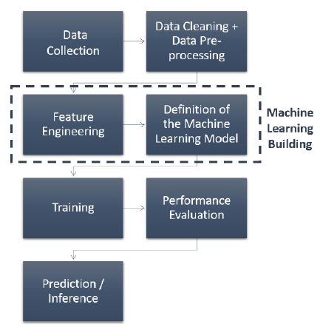
MACHINE LEARNING
Machine Learning (ML) is a subset of artificial intelligence (AI) that enables computers to learn patterns from data and make decisions without explicit programming.
It includes Supervised Learning (labeled data), Unsupervised Learning (finding patterns in unlabeled data), and Reinforcement Learning (learning through rewards).
ML is widely used in image recognition, speech processing, fraud detection, autonomous vehicles, and healthcare.
In this study, ML is used to detect seat occupancy, baby presence, and whether a baby is covered, improving automotive safety.
Machine Learning Components

Slide 5
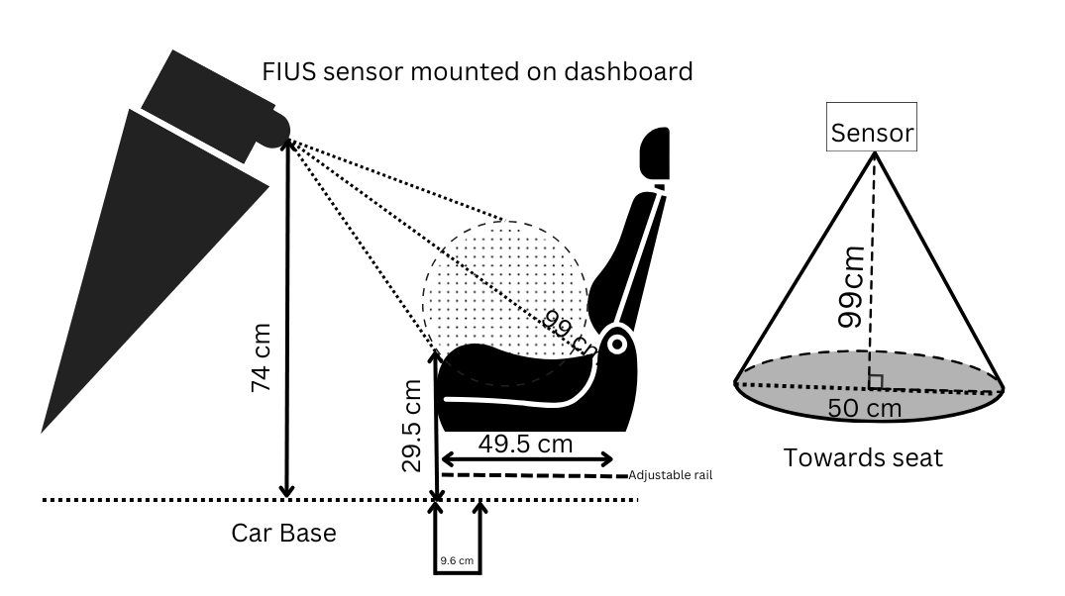
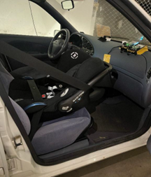
IMPLEMENTATION
A Ford Fiesta v16 model was used for real-time data collection purposes.
A Red Pitaya measurement board with an FIUS ultrasonic sensor was strategically mounted on the dashboard on the passenger side.
In our experiment, data acquisition can be performed directly in either ADC (Analog-to-Digital Converter) format or FFT (Fast Fourier Transform) format. However, we specifically opted to collect data in ADC format and subsequently convert it into FFT manually. This approach was chosen to enhance the accuracy and control over the signal processing pipeline.
The GUI software plays a critical role in configuring the measurement parameters and facilitating data collection.
Measurement Set-up

Slide 6
MODEL TRAINING
To classify passenger seat occupancy and detect the presence of a baby in a baby carrier seat, different machine learning models were employed. The classification was divided into two tasks:
Passenger Seat Occupancy Detection: To determine whether a seat was empty or mounted with a baby carrier seat, Extreme Gradient Boosting (XGBoost) and a Multilayer Perceptron (MLP) neural network were utilized. These models were trained on labeled seat occupancy data to distinguish between an empty seat and one containing a baby carrier effectively.
Baby Presence Detection: To classify whether a baby was present in the baby carrier, a Random Forest (RF) classifier and a Support Vector Machine (SVM) were implemented. These models were trained to differentiate between an occupied baby carrier with and without a baby inside.
Baby Presence Detection with Obstructions: To determine whether a baby was present in a baby carrier even when covered with a blanket or sunscreen, an Extreme Gradient Boosting (XGBoost) model was utilized These models were trained on labeled data to distinguish between an occupied baby carrier without baby and one where the baby was obscured by coverings.
The dataset was split into 80% for training and 20% for testing to ensure robust model evaluation. A confusion matrix and classification report were generated for each classification task to assess model performance, analyze misclassification patterns, and refine model parameters accordingly.

Slide 7
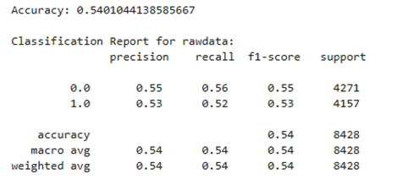
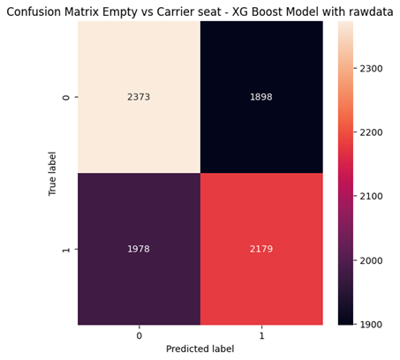
PASSENGER SEAT OCCUPANCY DETECTION
Initial XGBoost Model Training with Raw data:

Slide 8
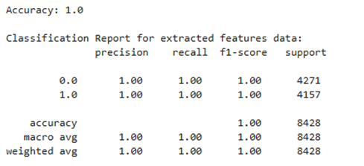
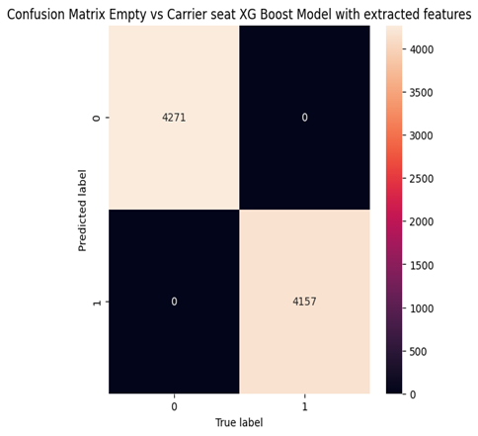
PASSENGER SEAT OCCUPANCY DETECTION
Re-training XGBoost model after Feature Extraction and Augmentation

Slide 9
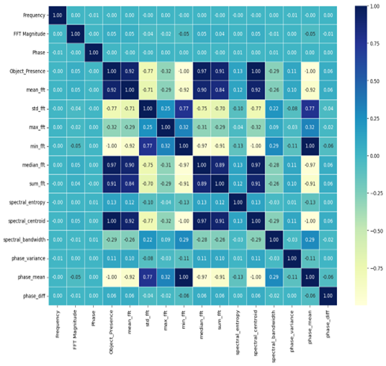
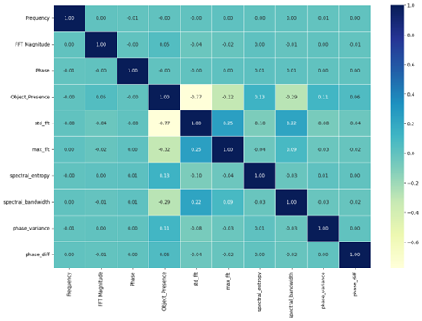
PASSENGER SEAT OCCUPANCY DETECTION
Addressing Overfitting Using Feature Selection
Dropped features: {'mean_fft', 'spectral_centroid', 'sum_fft', 'min_fft', 'median_fft', 'phase_mean'}

Slide 10
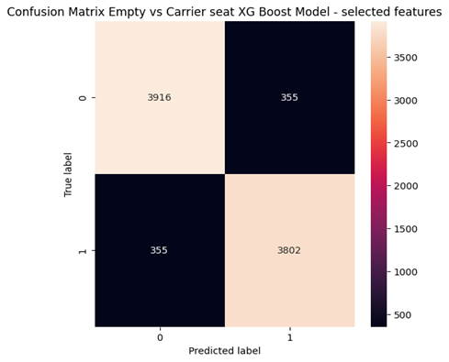
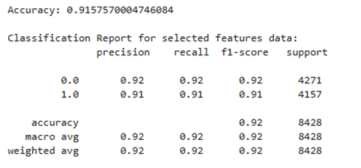
PASSENGER SEAT OCCUPANCY DETECTION
Re-training XGBoost model after Feature selection

Slide 11
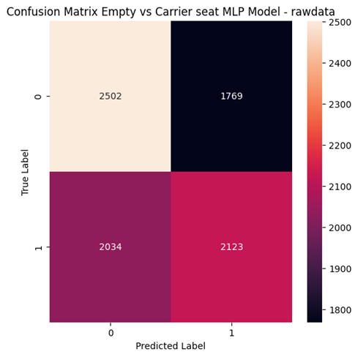
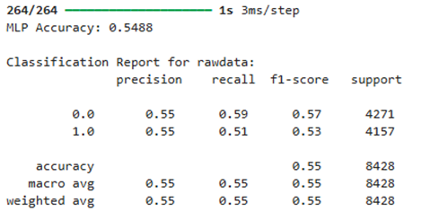
PASSENGER SEAT OCCUPANCY DETECTION
Initial MLP Model Training with Raw data:

Slide 12
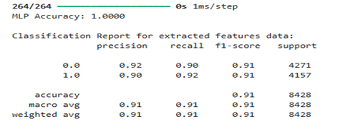
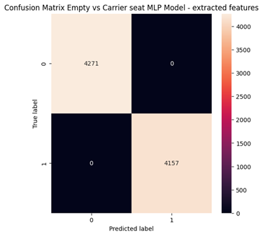
PASSENGER SEAT OCCUPANCY DETECTION
Re-training MLP model after Feature Extraction and Augmentation

Slide 13
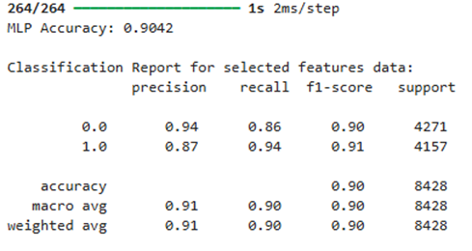
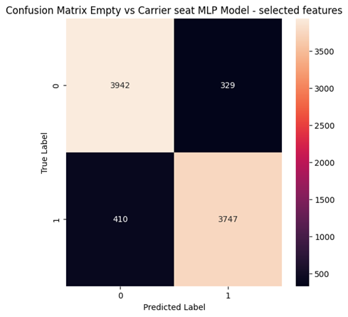
PASSENGER SEAT OCCUPANCY DETECTION
Re-training MLP model after Feature selection

Slide 14
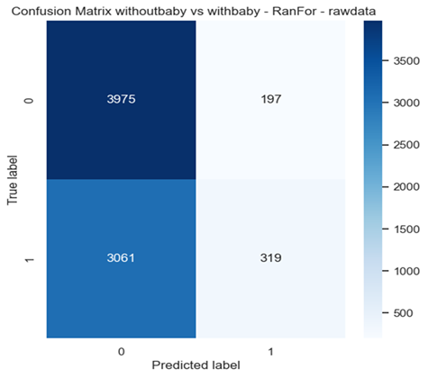
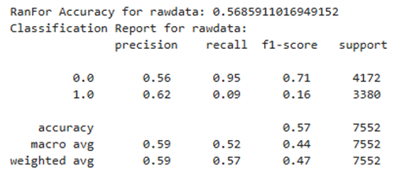
BABY PRESENCE DETECTION
Initial Random Forest Model Training with Raw data:

Slide 15
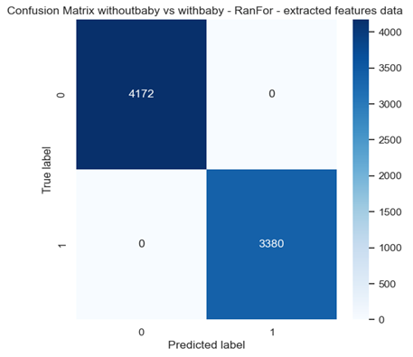
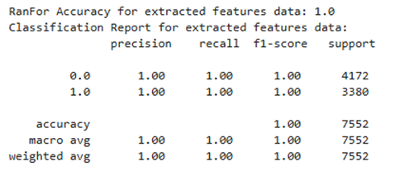
BABY PRESENCE DETECTION
Re-training Random Forest model after Feature Extraction and Augmentation

Slide 16
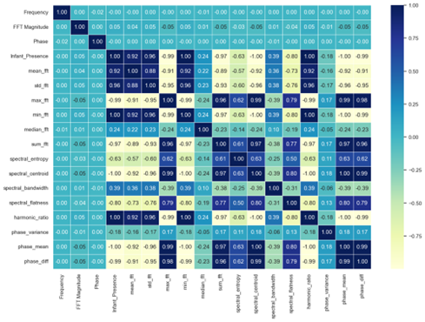
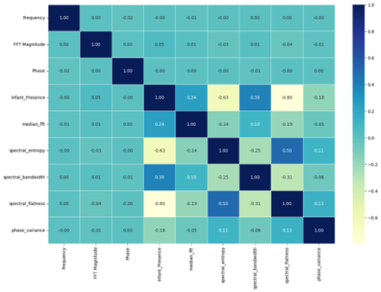
BABY PRESENCE DETECTION
Addressing Overfitting Using Feature Selection
Dropped features: {'phase_diff', 'mean_fft', 'phase_mean', 'min_fft', 'std_fft', 'sum_fft', 'max_fft', 'spectral_centroid'}

Slide 17
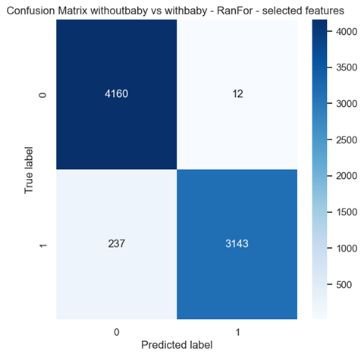
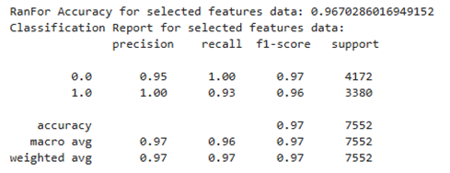
BABY PRESENCE DETECTION
Re-training Random Forest model after Feature selection

Slide 18
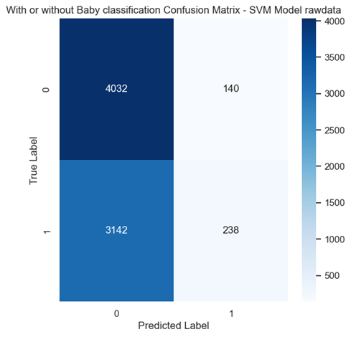
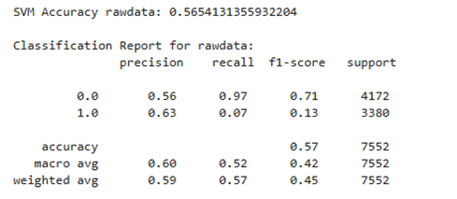
BABY PRESENCE DETECTION
Initial SVM Model Training with Raw data:

Slide 19
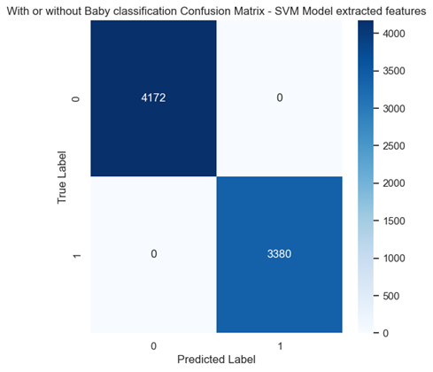
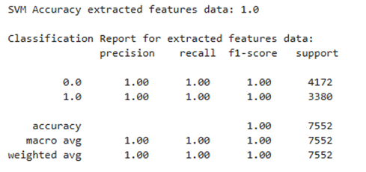
BABY PRESENCE DETECTION
Re-training SVM model after Feature Extraction and Augmentation

Slide 20
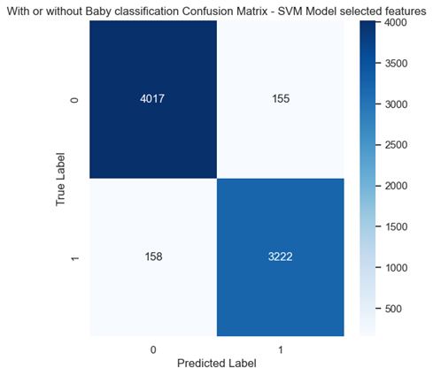
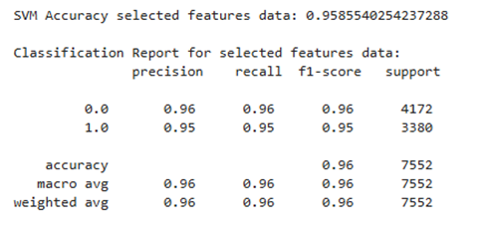
BABY PRESENCE DETECTION
Re-training SVM model after Feature selection

Slide 21
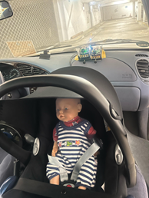
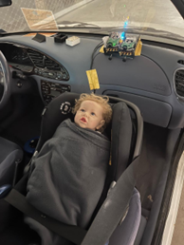
BABY PRESENCE DETECTION WITH OBSTRUCTIONS
Baby covered with Sunscreen and Blanket

Slide 22
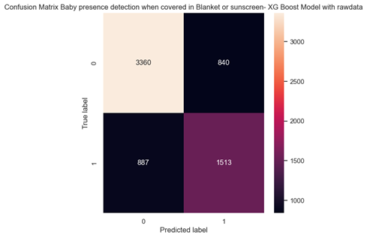
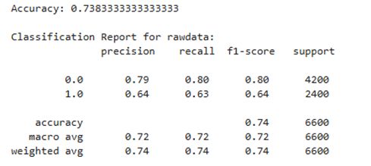
BABY PRESENCE DETECTION WITH OBSTRUCTIONS
Initial XGBoost Model Training with Raw data:

Slide 23
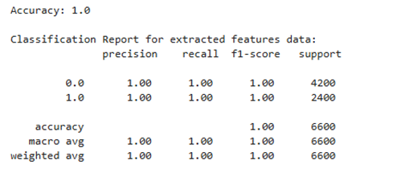
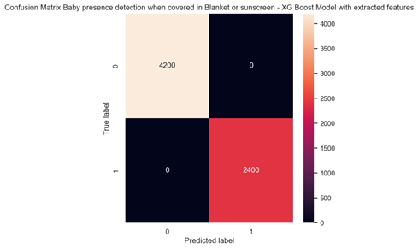
BABY PRESENCE DETECTION WITH OBSTRUCTIONS
Re-training XGBoost model after Feature Extraction and Augmentation

Slide 24
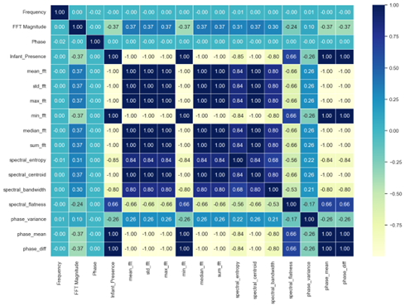
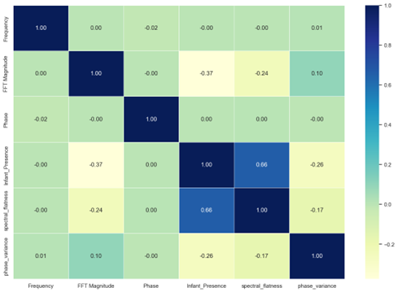
BABY PRESENCE DETECTION WITH OBSTRUCTIONS
Addressing Overfitting Using Feature Selection
Dropped features: {'mean_fft', 'min_fft', 'phase_mean', 'spectral_centroid', 'sum_fft', 'max_fft', 'phase_diff', 'spectral_entropy', 'std_fft', 'median_fft', 'spectral_bandwidth'}

Slide 25
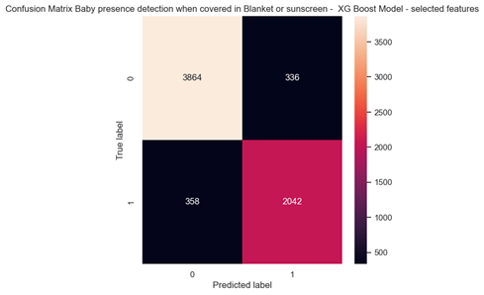
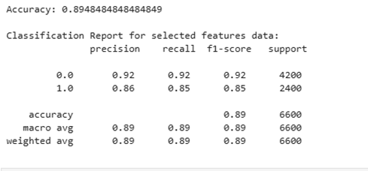
BABY PRESENCE DETECTION WITH OBSTRUCTIONS
Re-training XGBoost model after Feature selection

Slide 26
CONCLUSION
This study developed a sensor-based machine learning system for detecting seat occupancy and infant presence, including occlusion-invariant detection.
XGBoost, MLP, RF, and SVM classifiers effectively handled different detection tasks, with feature engineering playing a key role in performance enhancement.
Challenges such as overfitting, model interpretability, and computational efficiency highlighted the need for refined validation strategies.
The research contributes to autonomous safety systems by providing a scalable and intelligent monitoring solution.
Future work should focus on adaptive learning, real-time deployment, and multi-sensor fusion to improve robustness and generalization.

Slide 27
THANK YOU

